Slide 1
2pm-5pm GMT; 3pm-6pm CET; 9am-noon EST

Slide 2
A concession is any arrangement in which a firm obtains from the government the right to provide a particular service under conditions of significant market power.

Slide 4
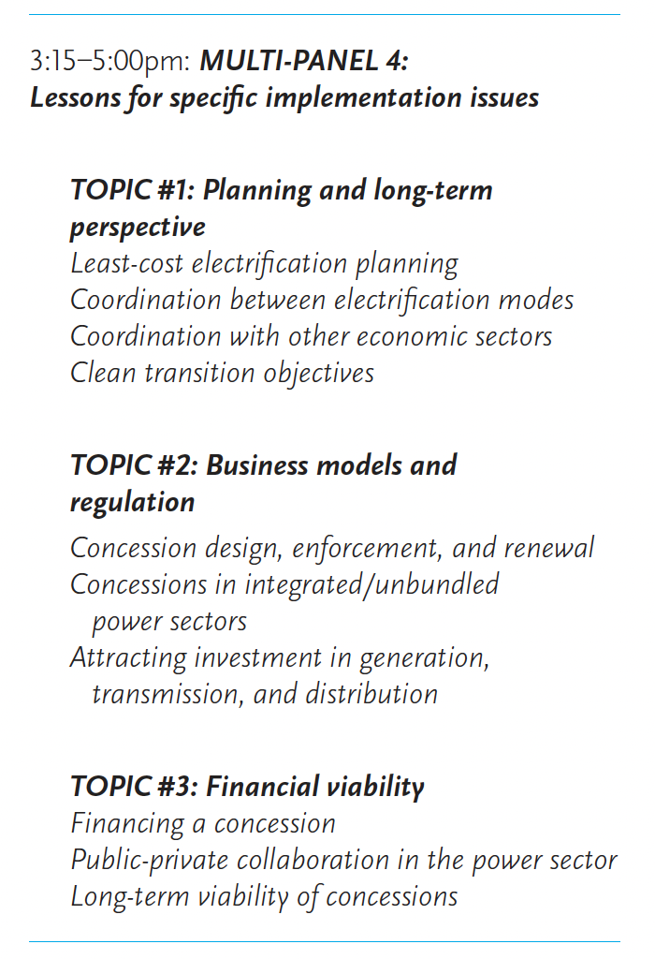

Slide 5
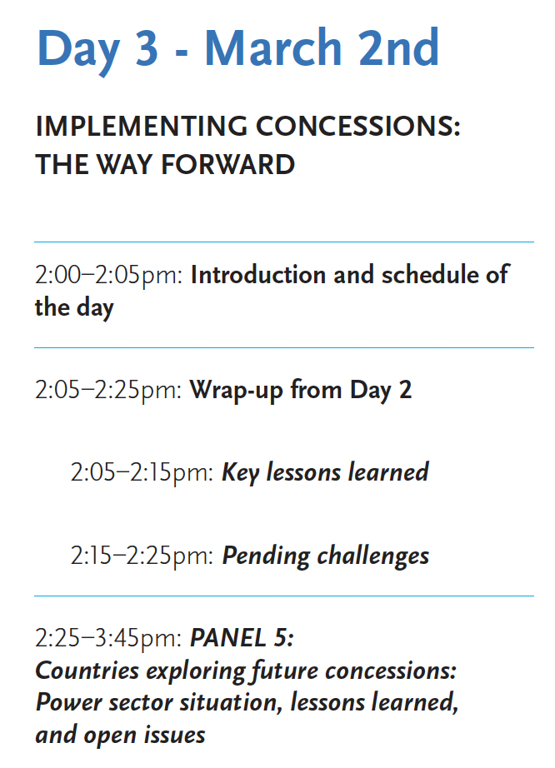

Slide 6
Learnings
“When supported by the government, properly incentivized, and placed within an appropriate legal framework, concessions can be a useful tool for attracting private resources, managerial expertise, and technical know-how to address the enormous challenge of rural electrification.”
“Indeed, concessions can potentially accelerate rural electrification in ways that neither the public nor the private partner can accomplish on its own.”

